Slide 1
String Matching Algorithms

Slide 2
STRING MATCHING OR PATTERN MATCHING
Text:
“G E E K S F O R G E E K S”
0 1 2 3 4 5 6 7 8 9 10 11 12
Pattern: “G E E K”
0 1 2 3
Pattern found at index 0 and 8
To check if a pattern is present in a given text. Text- T[1,2,.....,n], Pattern- P[1,2,......,m], n>m

Slide 3
Types of String Matching Algorithms
Naive’s Algorithm / Brute Force Algorithm
Rabin-Karp Algorithm
Knuth-Morris-Pratt Algorithm (KMP)

Slide 4
Naive’s Algorithm / Brute Force Algorithm
Example 1:
T:
P:
s ← 0 to n-m
To Check: P[1] = T[s+1]
P[2] = T[s+2]
P[3] = T[s+3]
hence P[m] = T[s+m], Valid shift = ‘s’
a | b | c | a | b | a | b | a | b | b | a
1 | 2 | 3 | 4 | 5 | 6 | 7 | 8 | 9 | 10 | 11
a | b | a | b
1 | 2 | 3 | 4

Slide 5
T: | a | b | c |  | a |  |  |  |  |  | b | b | c
P: | a | b a | a b a |  |  |  |  |  |  | s=0 x s=1 x s=2 x
 |  |  |  |  |  |  |  |  |  | s=3 Match & also at s=5
Example 2:
T: a P: a |  | b b | c a | a a |  | b | a | a | b |  | c | a | b | a | c
a b a b | b b a | a b | b
a | b | a | b
Try Yourself..!

Slide 6
Algorithm
Naive_String_Matching (T, P)
n ← len (t)
m ← len (p) for s ← 0 to n-m do
if P[1,....,m] = T[s+1,......,s+m]
then
print(“ Pattern occurs with shift s”)
Time Complexity: O((n-m+1)*m)
T(n,m): O(nm)
Drawback: We are incrementing s by only 1.

Slide 7
Rabin-Karp Algorithm
Example 1:
T: 2 3 5 9 0 2 3 1 4 1 5 2 6 7 3 9 9 2 1
P: 3 1 4 1 5
∑ = { 0,1,2,.....,9 }
Solution:
Select a prime number, used to find the mod value of the given pattern which is referred as hash value.
Rabin Karp algorithm compares string’s hash values rather than comparing the
string itself.
T[s+1,.....,s+m] mod q can be incrementally computed by subtracting the higher order digit, shifting and then adding the lower order digit of the next substring. All operations are done with mod q arithmetic.

Slide 8
T: 2 3 5 9 0 2 3 1 4 1 5 2 6 7 3 9 9 2 1
P: 3 1 4 1 5
q = 13 (Randomly selected)
Radix = 10
P % q = hash value
31415 % 13 = 7
Now
23590 % 13 = 8 | 41526 % 13 = 9
35902 % 13 = 9 | 15267 % 13 = 5
59023 % 13 = 3 | 52673 % 13 = 10
90231 % 13 = 11 | 26739 % 13 = 11
02314 % 13 = 0 | 67399 % 13 = 7 ( Spurious Hit)
23141 % 13 = 1 | 73992 % 13 = 9
31415 % 13 = 7 (Actual Hit) | 39921 % 13 = 5
14152 % 13 = 8

Slide 9
14152 = [( 31415 – 3 * 10⁴ ) * 10 + 2 ] mod 13
[( 31415 – 30000 ) * 10 + 2 ] mod 13
[ 1415 * 10 + 2 ] mod 13
[ 14152 ] mod 13
= 8

Slide 10
Example 2:
T: 3 4 1 5 9 2 6 5 3 5 8 | 9 | 7 | 9 | 3
P: 2 6
Prime no q = 11
Solution:
Radix = 10
P % q = hash value
26 % 11 = 4
34 % 11 = 1 |  |  |  |  | 35 % 11 = 2
41 % 11 = 8 15 % 11 = 4 (Spurious Hit ) 59 % 11 = 4 (Spurious Hit ) 92 % 11 = 4 (Spurious Hit ) |  |  |  |  | 58 % 11 = 3 89 % 11 = 1 97 % 11 = 9 79 % 11 = 2
26 % 11 = 4 ( Actual Hit ) |  |  |  |  | 93 % 11 = 5
65 % 11 = 10
53 % 11 = 9

Slide 11
41 = [( 34 -3 * 10¹ )* 10 + 1] mod 11
[( 34 – 30) * 10 + 1] mod 11
[ 4 * 10 + 1 ] mod 11
[ 41 ] mod 11
= 8
Applications: Bio-informatics to see similarities of proteins.

Slide 12
Example 3:
Prime no q = 13
Apply Rabin Karp algorithm to check the presence of pattern in the given text.
Find the number of Spurious hit and exact hit.
Try Yourself...!
T: | 4 | 2 | 1 | 5 | 8 | 3 | 6 | 6 | 3 | 4 | 8 | 9 | 1 | 9 | 3 | 5 | 0 | 6 | 6 | 3
P: | 6 | 6 | 3

Slide 13
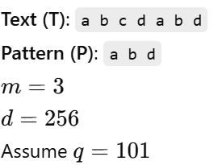
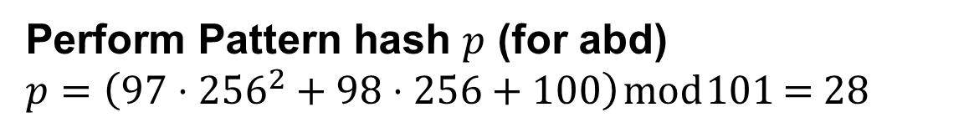
How to work with Strings?
The ASCII values of a = 97, b = 98,
c = 99, d = 100
Perform Pattern hash $p$ (for abd)
$p=\left(97⋅{256}^{2}+98⋅256+100\right) mod 101$ = 28
Group the given text into strings of 3 characters and find the hash value same as above
- (i.e.) abc - 90, bcd - 31, cda - 56, dab – 28, abd - 28
Proceed with the identification of Hits as Valid and Spurious Hits
- 2 Hits, 1 valid and 1 spurious
Do a character wise comparison of the matched hash values

Slide 14
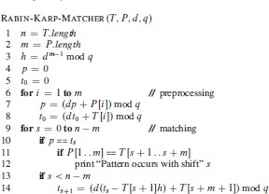
Time complexity : Worst Case
T (n,m) = O(m) + O((n-m+1)*m)
= O(mn)
Avg Case
T (n,m) = O(m) + O(n-m+1) = O(m+n)

Slide 15
Knuth-Morris-Pratt Algorithm (KMP)
Consider an example
i | 1 | 2 | 3 | 4 | 5 | 6 | 7 | 8 | 9 | 10
T: | a | a | a | a | a | a | a | a | a | b
j | 1 | 2 | 3 | 4 | 5
P: | a | a | a | a | b
With Naive algorithm, more number of comparisons.

Slide 16
KMP algorithm two components
Prefix Function π - Compares P with itself
KMP Matcher – Compares text T with Pattern P and uses π
A prefix function π gives the information about the pattern “P” matches against shifts of itself.
π[q] is the length of the longest prefix of “P” that is a proper suffix of P_{q}

Slide 17
Given the pattern P, compute prefix function.
1.
q | 1 | 2 | 3 | 4 | 5
P[q] | b | a | b | a | b
π[q] | 0 | 0 | 1 | 2 | 3
2.
q | 1 | 2 | 3 | 4 | 5
P[q] | a | b | a | b | b
π[q] | 0 | 0 | 1 | 2 | 0

Slide 18
3.
q | 1 | 2 | 3 | 4 | 5 | 6 | 7 | 8 | 9 | 10
P[q] | a | b | a | b | a | b | a | b | c | a
π[q] | 0 | 0 | 1 | 2 | 3 | 4 | 5 | 6 | 0 | 1
4.
q | 1 | 2 | 3 | 4 | 5 | 6 | 7
P[q] | a | b | a | b | a | c | a
π[q] | 0 | 0 | 1 | 2 | 3 | 0 | 1
P = b a c b c b a c a b
P = a c b c a c b a c d b a
Try Yourself..!

Slide 19
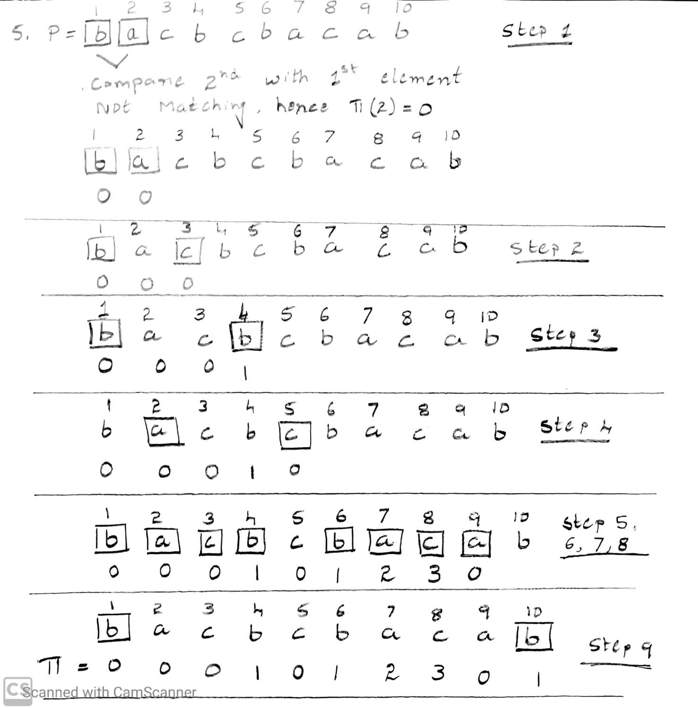

Slide 20
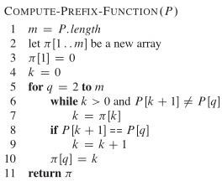

Slide 21
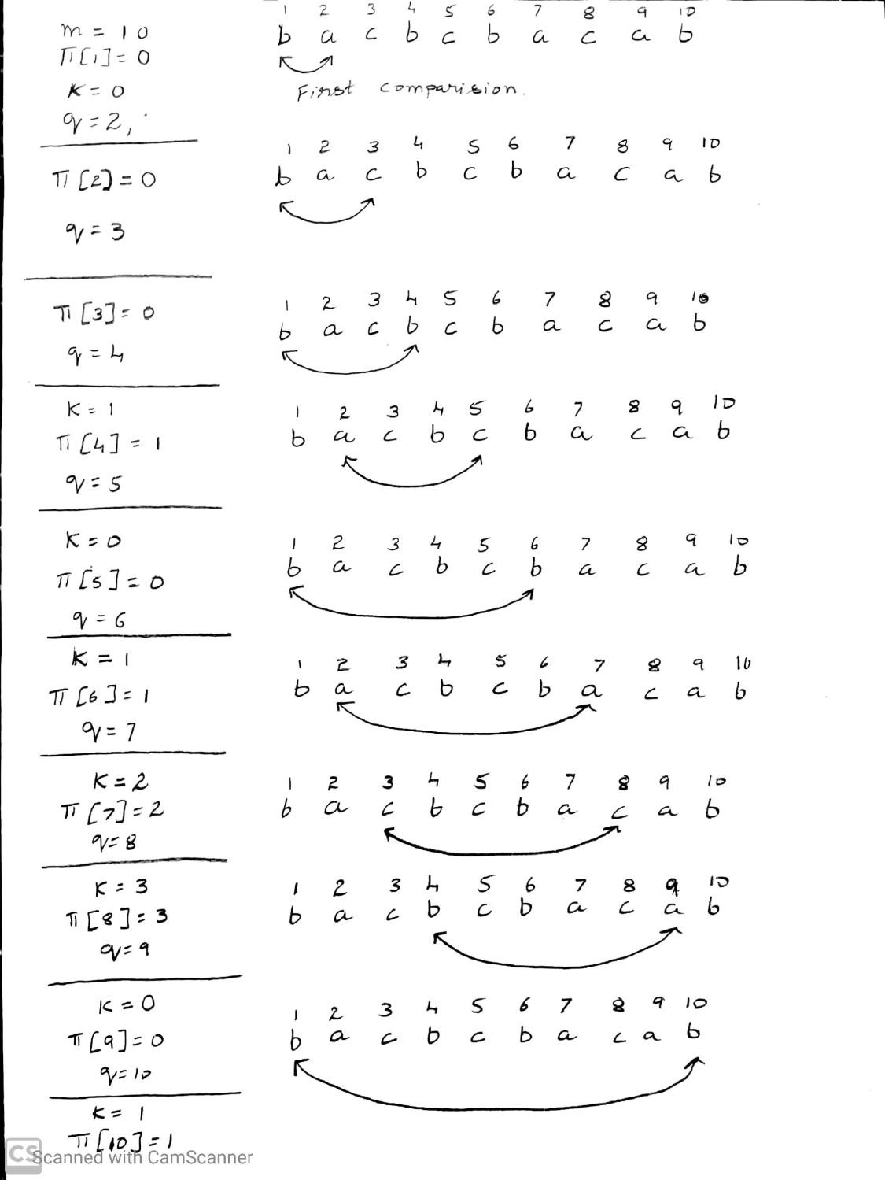

Slide 22
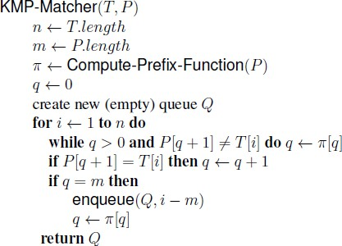

Slide 23
Example 1:
T: a | b | a b | a | b | a | b | b
P: a | b | a b | b
Solution:
Find the prefix values
q | 1 | 2 | 3 | 4 | 5
P[q] | a | b | a | b | b
π[q] | 0 | 0 | 1 | 2 | 0

Slide 24
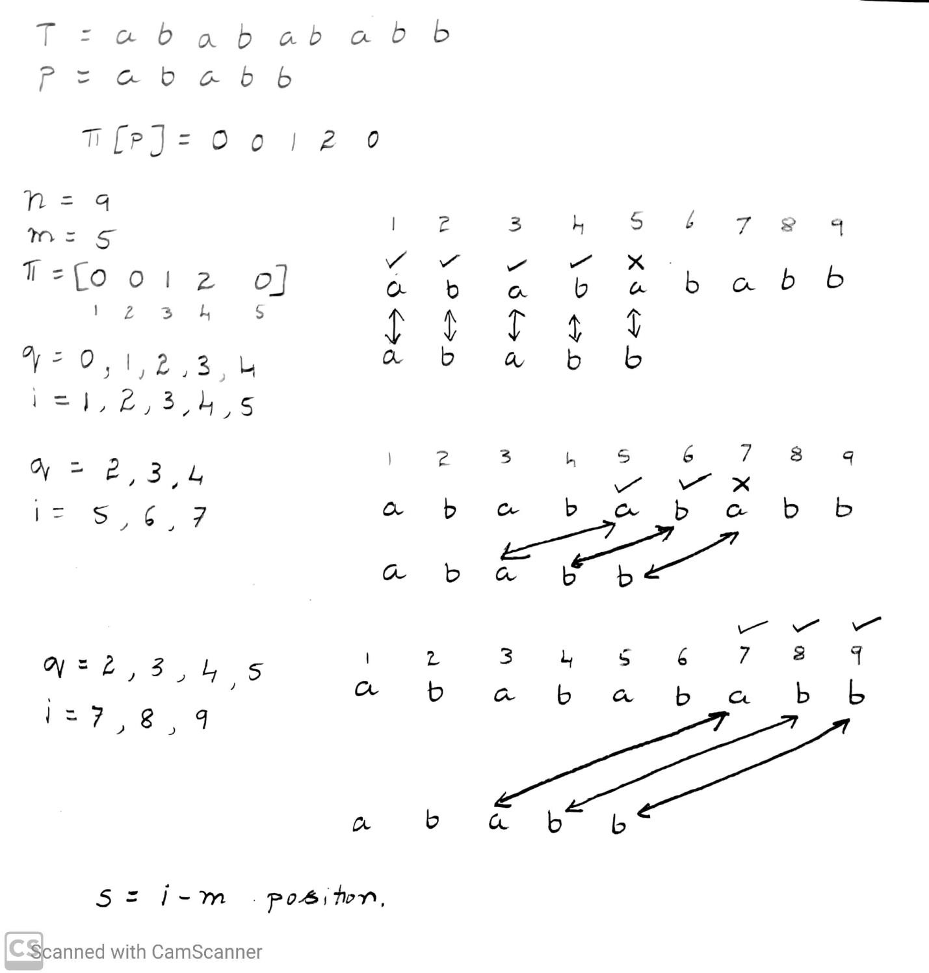

Slide 25
T: a b a b
Trace the algorithm.
a b a b b
P: a b a b b
a b a b b
a b a b b Print occurs with 4 shift.
Analysis: T(n,m) = O(m) + O(n+m)
π fn KMP Matches

Slide 26
Applications: Intrusion Detection, DNA string search
KMP: High speed multi stream packet scanning Naive: Keyword search in large datasets
Rabin Karp: Higher dimensional pattern matching Problems
Example 2:
T: b a c b a b a b a a a b c b a b P: a b a b a c a
Try yourself..!

